Slide 1

OralPro Connect™
A platform designed specifically for Dental professionals with valuable resources for fostering collaboration, knowledge sharing, and professional growth

Slide 2
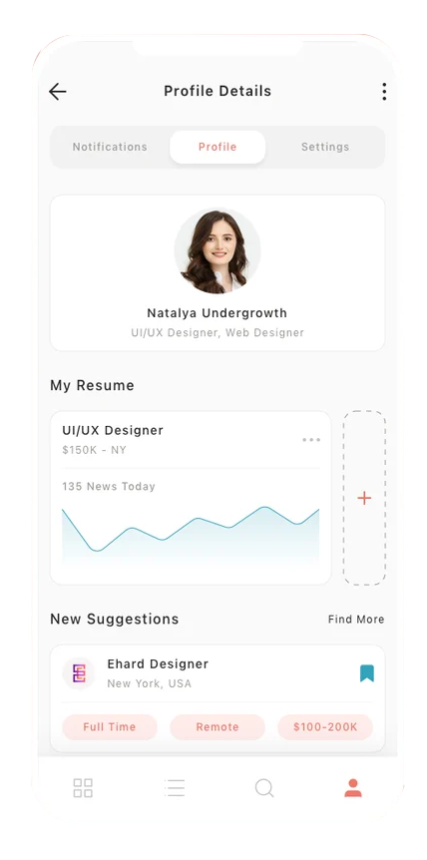
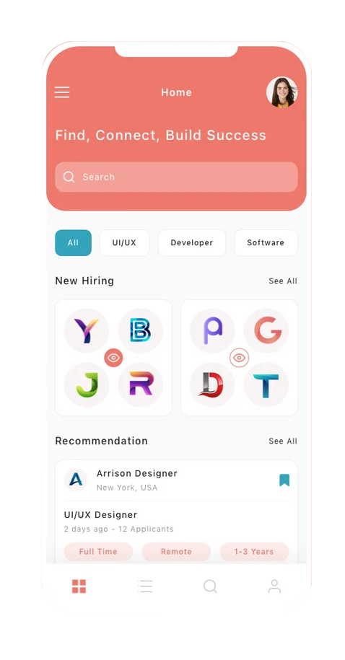

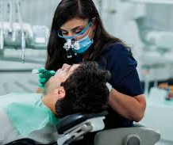

PLATFORM OVERVIEW
Empower 3,00,000+ Oral Health Practitioners in India with resources, education, and support for excellence in Oral Health care
Find Connect & Collaborate
Dr. Monica Das
All
CME
Content
More
Dental Practitioner
Profile overview
Comprehensive Content Library
LIVE CME/CPD Programs (including accreditation)
Module for Continuing Education & Certifications
24/7 AI Support for Clinical Assistance
Related Content
Overview
Weekly CME flow
Dr. Padma Singh
Role of the Oral Microbiome in Periodontal Disease – Exploring microbial diversity and treatment options.
Osseointegration of Dental Implants – Advances in surface modifications for better outcomes.
Poll
Exclusive rights to branding, promotional content, activities, and access to OHP data for Godrej pet products
Is laser dentistry worth the investment for general dental practices?
25 Jan 2025
30 Jan 2025
Register
Register
Yes
No
May be

Slide 3

Q
#OHP VIEW ON PROFESSIONAL DEVELOPMENT
TARGET SEGMENT
What activities do you engage in for your professional development? [n=250]
CONTENT TAGS
3,00,000+
Oral Health Practitioners
Pan India
#DentalCare #HealthySmile #TeethCleaning #SmileMakeover #DentalTips #Braces #CosmeticDentistry #FamilyDentist #OralHygiene #TeethWhitening #Invisalign #SmileGoals #DentalImplants #ToothHealth #RoutineCheckup #PediatricDentistry #StraightSmile #AestheticDentistry #RootCanalTreatment #BrightSmile #KidsDentist #SmileDesign #CavityFilling #HealthyTeethForKids #FlossAndBrush #AlignYourTeeth #OrthodonticCare #HappyLittleSmiles #ToothRepair #PreventiveCare #DentalRestoration #CrownsAndBridges #FunAtTheDentist #SmileCorrection #HollywoodSmile
65,000+
Dental clinics including Govt and private hospitals
400+
Colleges including govt, privately, and semi-government institutions
Dr.. Ankit Bhagora, Ahmedabad
Dr. Neha Yadav, Ahmedabad
Dr. Rinki Arya, NoidaDehradun
Dr. Dr. Rajat Majumder,
Dr Bharkar Mujherjee , Koltaka
Dr. Soham Chatterjee, Kolkata
Dr. Payal Kedia, Kolkata
Dr. Karishma Jaradi, Mumbai
Dr. Noorudheen Mn, Kerala
Dr. Manisha Mehta, Mumbai
8-10
Patient capacity per doctor per day in a single-chair setup
Top Contributing OHPs

Slide 4







KEY SERVICES OR OFFERINGS FOR OTPs
Comprehensive Resource Library
The Resource Library features curated oral health real-world evidence (RWE) content, including peer-reviewed articles and clinical guidelines from top organizations. It also provides a platform for sharing challenging case studies and discussing the latest trends, innovations, and best practices in oral heath.
LIVE CME/CPD Programs & Conference Updates
This module includes live sessions for continuing medical education (CME) and hosting virtual and hybrid conferences, featuring panel discussions and webinars with industry experts and thought leaders. Additionally, platform will provide updates on global events and conferences to engage the audience.
Continuing Education & Certifications
The platform will offer a variety of accredited online courses covering key dental topics, ranging from basic oral health care to advanced surgical techniques. In addition, we will collaborate with leading dental colleges and associations to provide certification programs in specialized fields.
Dental Jobs and Freelancing Opportunities
This platform connects dentists with full-time, part-time, and freelance opportunities tailored to their expertise. It bridges skilled professionals and clinics, offering roles in general dentistry, orthodontics, periodontics, and more. With easy access to job listings and project-based work, it empowers dental professionals to advance their careers flexibly.
Awareness
Views, Impressions, Unique Users, Awareness Lift, Ad Recall Lift
Consideration
Activity Engagement, Time Spent, View Through Rate, Repeat Users
Action
Clicks, Calls, Signups, Leads, Product Interest, Recommendation Intent
ENGAGEMENT METRICS

Slide 5




KEY INGREDIENTS TO KICK START THE ENAGAGEMENT
\
\
\
USER PLATFORM
PLATFORM CONTENT
Jobs and Freelancing
Website and Mobile App Development: A user-friendly and responsive website, along with mobile applications for easy access
Content Management System (CMS): Implement a robust CMS to manage content updates, forums, and user-generated content
Database Management: A secure database to store user profiles, forum discussions, educational resources, and content postings
Content Creation: Curate and share up-to-date clinical guidelines, research papers, and oral heath literature
Partnerships and Collaborations: Partner with institutions and associations for user acquisition and content creation
AI Integration and UAT: Ensure the AI system has access to a comprehensive database for accurate responses. Robust UAT feedback to scale the platform acquisition and reach
Comprehensive Job Listings: Explore full-time and part-time opportunities across private practices, hospitals, and corporate dental networks.
Freelancing Work: Access short-term projects or freelance assignments for specialized procedures, consultations, or locum tenens work.
Professional Networking: Connect with clinics, peers, and organizations to expand your professional reach.

Slide 6
ESTIMATED OUTCOME IN 12 MONTHS
#Acquisition
#Engagement
#Content
Data-driven estimates to optimize experience and engagement
60,000+
Acquiring OHPs in 12 Months
1560K+
Branded touchpoint delivery
12,000+
Multiformat content and activities

Slide 7
USER ACQUISITION JOURNEY
Dedicated Team
Institutional Relationship Manager
Association Relationship Manager
Omnichannel Lead
ACTIVITY
Partnerships with Dental
Associations
ACTIVITY
Activities, Webinars and Live CME Sessions
ACTIVITY
Paid Promotions, Re-engagement and omnichannel
THE FOUNDATION STAGE
LAUNCH STAGE
THE HARVESTING STAGE
CONSISTENT LEADs/ ACTIVITIES
0-90 days
90 – 180 Days
365 days
OUTCOME
Credibility, resonance & awareness in mass via association and institutions
OUTCOME
Direct engagement with OHPs, showcasing the platform’s value
OUTCOME
Increased organic traffic from OHPs seeking educational content, establishing the platform as a trusted resource and thought leader
Targeting 3,00,000+ OHPs in Metro, Tier 1 and Tier 2 Cities
Aiming 20%+ of companion OHPs on platform in one year with 100% awareness and noise in the segment

Slide 8
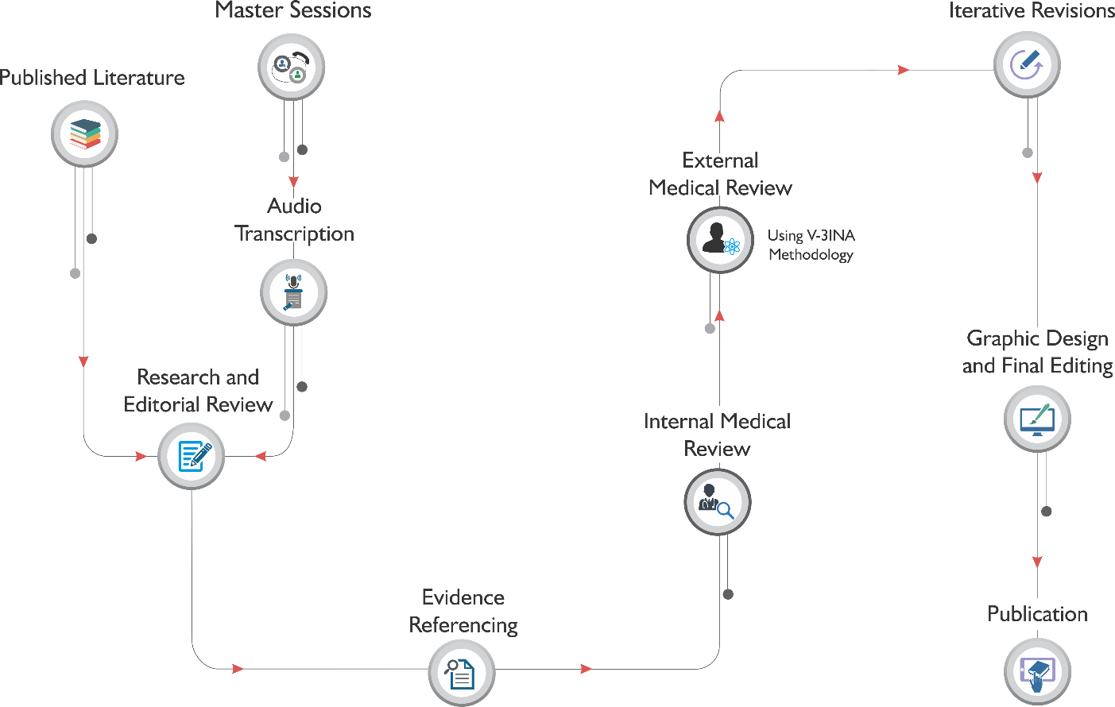
CONTENT STRATEGY
Clinical Recording
Dedicated Team
CMO – Platform Dev
Medical Writers
Content Strategist
Graphics Team
Video Editing Team
Copywriter & Editor
60%
Clinical Content
12,000+ multiformat content in 12 months
Launching with 800+ content pieces to kick start the platform and adding 1 -1.2K monthly pieces to make this a go-to-place for OHPs
Case study base content

Slide 9

ENGAGEMENT STRATEGY
Activation Data model will profile OHPs for the content campaigns
Persona Based
Content Journey
Dedicated Team
Campaign Lead
Dental Panel
Multichannel Team
Data Team
Engagement Team
60,000+
Naive
Vigilant
Enthusiasts
OHPs From metro, tier 1 and tier 2 cities
Content A
Content B
Content C
3X
Persona based content flow for identified OHPs
4X
Content per VCP
Touchpoint per month per VCP
60% Case study focused content
Targeting 1M+ Quality user touchpoints
in first 12 months
AI driven Individualised persona segmentation to drive 60%+ QAU,
100% reach in the target segment

Slide 10
TECHNOLOGY UPGRADE AND MAINTENANCE
Engineering Team
User Research, Model Building, and Database Setup
Conduct user research, build predictive models, and set up a comprehensive database for data management and analysis in 30 days.
Engg. Lead lead the implementation of
graph database along with
overseeing development
deliverables
Product Team
Full Time
Prod. Owner
Leads the entire product strategy, design, in-charge for delivery and point of contact
Full Time
Backend Engg.
API development, database query and business logic handling
Full Time
Design, Development, Testing, Deployment and Launch
Oversee the design, development, testing, deployment, and launch processes to deliver a fully functional product within 90 days.
Frontend Engg.
Handles integration and UI
creation on the frontend
Prod. Strategist
Works on creating the
documents, wireframes, doing
user research
Full Time
Fractional
QA Engg.
Writes the test cases, and
performs functional, integration
testing. Performance testing pre-deployment
Full Time
Prod. Designer
Works on wireframes with Prod.
Strategist. In charge of visualization of requirements.
Understands information hierarchy, UI principles and UX
challenges
Fractional
Maintenance and Updates
Ensure ongoing maintenance and implement regular upgrades to enhance product performance and reliability, ongoing activity post launch.
ML Associate
the data clean up,
classification and parameter map
Full Time
We estimate 3 months to launch the platform. We will plan, build and iteratively deploy the product features. With an ongoing monthly review of what new feature or initiative or update to pick up.

Slide 11
WHAT DO YOU GET EXCLUSIVELY
Top of the Funnel
Middle of the Funnel
Bottom of the Funnel
Business Intelligence
100% Ad Inventory for Brand Reminders
Branded Content and Activities
Lead Generation and KOL Management
VCP Behavior, Market Research and Surveys
Branded Ads
Motion Ads
Static Ads
Intrusive Ads
Interstitial Ads
Promotional Ads
In-Stream Ads
Interactive Ads
In-Video Overlays
Banner Overlays
Pop-Up Reminders
Sponsored Content
Native Advertising
Content Sponsorships
Article Promotion
Influencer Collaborations
Social Media Promotions
Content Syndication
Webinars
Case Studies
KOL Videos
ISP Programs
Lead Capture Forms
Landing Pages
Marketing Campaigns
KOL Outreach Programs
Event Sponsorships
KOL Endorsements
Influencer Partnerships
Educational Workshops
Speaking Engagements
Engagement Analytics
Competitive Analysis
Market Trend Analysis
Brand Perception Studies
Product Feasibility Studies
Pricing Strategy Research
Online Feedback Surveys
NPS Surveys
1560000+
Direct touchpoints and building digital outreach channel for marketing
60,000+
Direct access to OHPs in metro, tier 1 and tier 2 cities
F2F or Virtual
Direct leads and interactions with your field forces or virtual MSLs
MILLIONS
Data points to enhance and refine marketing and product strategies

Slide 12
ESTIMATED BUDGET (SaaS Model)
PART I – IMPLEMENTATION [ONE TIME] | BUY TYPE | ESTIMATED COST | DESCRIPTION
VCP Platform implementation in 90 days | One Time Cost | ₹ 56,20,000 | One time implementation cost for platform for scientific exchange, A user-friendly and responsive website, along with mobile applications for easy access with CMS and integrated CRM
Initial content strategy and content to launch the platform in 90 days | One Time Cost | ₹ 39,90,000 | 500 pieces of multiformat content for platform launch and initial feature enrichment
PART II – ACQUISITION, ENGAGEMENT AND CONTENT [MONTHLY COST] | BUY TYPE | ESTIMATED COST | DESCRIPTION
Acquisition team to acquire 15,000 VCPs | Monthly Recurring Cost | ₹ 6,60,000 | Building credibility and trust through association endorsements. Access to a wide network of veterinary professionals, leading to 15,000+ sign-ups and re-engagement. Long-term partnerships to provide a steady stream of users.
Engagement team to drive traffic, and campaign to deliver 800,000+ touchpoints | Monthly Recurring Cost | ₹ 12,90,000 | The Engagement Team drives traffic and executes campaigns by using data analytics to target key demographics and create engaging content, ensuring effective conversions into loyal users. Including communication, speaker management, endorsement and any other VCP management cost.
Content team to add and publish 200+ content pieces monthly | Monthly Recurring Cost | ₹ 13,60,000 | Professionals to strategize and support in creating high-quality scientific content, including articles, videos, and interactive learning materials. Create and publish 200 content pieces every month.
Platform maintenance, upgrade, ML ops, and quality during exclusivity period | Monthly Recurring Cost | ₹ 2,80,000 | Monthly budget of maintenance, MLOps, DevOps, upgrades and to manage marketing infrastructure, including monitoring, maintenance, and updates for client portal.

Slide 13


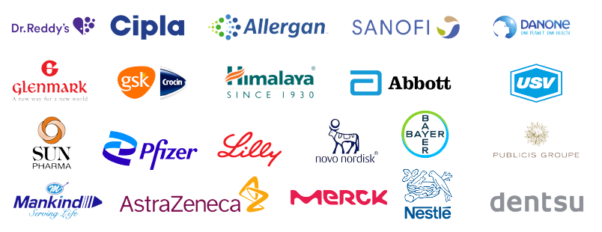



Key Clients Trending in Our Network:
Our process:
Even the right people and the right tools can fail without the right process. We ensure accuracy and efficiency using statistical methods, such as Six Sigma and Lean, project playbooks, and constant communication with you and your team.
Security:
Your privacy is important to us. All of our facilities are compliant with ISO 27001:2013 Information Security and Security Management System requirements.
info@clirnet.com
+91 8777839745
Contact us for more information

